Slide 1
CS 575
Design and Analysis of
Computer Algorithms
Professor Michal Cutler
Dynamic programming
Car Assembly, matrix multiplication

Slide 2
This class
Dynamic programming
Car assembly problem
Multiplication of a sequence of matrices

Slide 3
When is Dynamic
Programming used?
Used for problems in which an optimal solution for the original problem can be found from optimal solutions to subproblems of the original problem
Often a recursive algorithm can solve the problem. But the algorithm computes the optimal solution to the same subproblem more than once and therefore is slow.
Dynamic programming reduces the time by computing the optimal solution of a subproblem only once and saving its value. The saved value is then used whenever the same subproblem needs to be solved.

Slide 4
Principle of Optimality
(Optimal Substructure)
The principle of optimality applies to a problem (not an algorithm)
A large number of optimization problems satisfy this principle.
Principle of optimality:
Given an optimal sequence of decisions or choices, each subsequence must also be optimal.

Slide 5
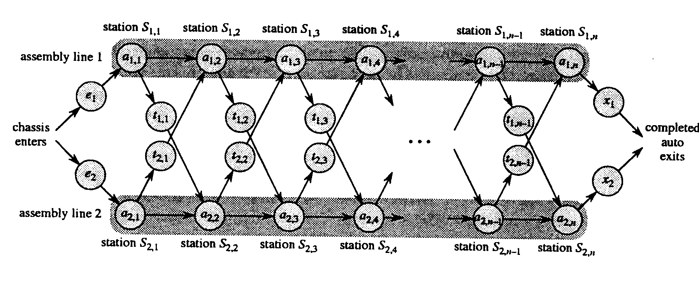
The special order car assembly problem
Compute the fastest way to build a car

Slide 6
The assumptions
2 assembly lines
Each with n stations
The time needed at station j is a_{i,j} where i denotes the assembly line
There is a possibility to move the car between assembly lines
The move requires time t_{i,j}

Slide 7
Optimal substructure
A problem is said to have optimal substructure if an optimal solution can be constructed efficiently from optimal solutions to its sub-problems. This property is used to determine the usefulness of dynamic programming and greedy algorithms.

Slide 8
Possible solutions
Enumeration of all 2^{n} possibilities – for each of the n stations e can choose either assembly line 1 or 2.
Writing a recursive program
Dynamic programming O(n)

Slide 9
Step 1: The structure of the fastest way
Fastest way through S_{1,j} is either:
  Fastest way through S_{1,j-1} and then directly to S_{1,j} or
  Fastest way through S_{2,j-1}, a transfer to line 1 and then through S_{1,j}
Fastest way through S_{2,j} is symmetrical

Slide 10
Step 2: The recursive solution
Let f_{i}[j] denote the fastest time to get from the starting point though station S_{i,j}
We need f* = min (f₁[n] + x₁, f₂[n] + x₂)
Note: at this point we are looking for the length of the best path (not yet looking for the best path)

Slide 11
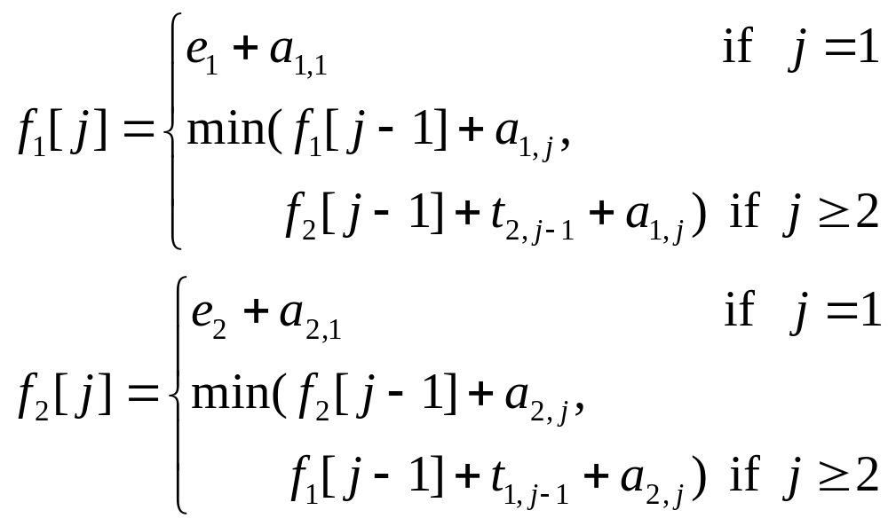

The recurrence equation

Slide 12
Recursive algorithm
f(i,j)
if j=1
return e[i]+a[i, 1]
else
return min(f(i, j-1)+a[i, j],
f(3-i, j-1)+t[3-i, j-1]+a[i, j])
Initial calls f(1, n) and f(2, n)

Slide 13
Call tree for computing f₁(n)
d calls
f₁(n)
0 1
f₁(n - 1)
f₂(n - 1)
1 2
f₁(n - 2)
f₂(n - 2)
f₁(n - 2)
f₂(n - 2)
2 4
f₁(n - 3)
f₂(n - 3)
f₁(n - 3)
f₂(n - 3)
f₁(n - 3)
f₂(n - 3)
f₁(n - 3)
f₂(n - 3)
3 8
f₁(1)
f₂(1)
n-1 2^{n-1}
Total number of calls for f₁₍n) 2^{n} –1
Total number of calls for f* 2^{n+1} –2

Slide 14
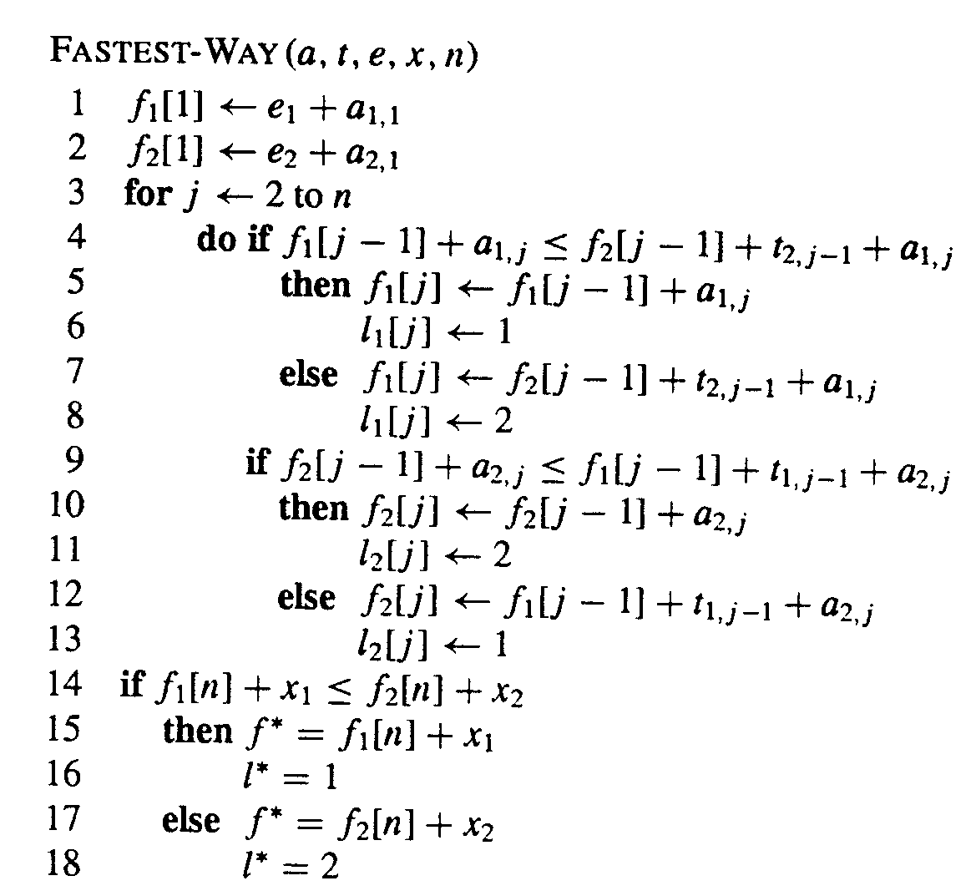
Step 3:The computation
Algorithm linear in n

Slide 15
Step 4: constructing the path
PRINT-STATIONS(L, n)
i ← L*
print “line” i “station” n
for j ← n downto 2
i ← L[i,j]
print “line” i “station” j-1
Order of print? Time?

Slide 16
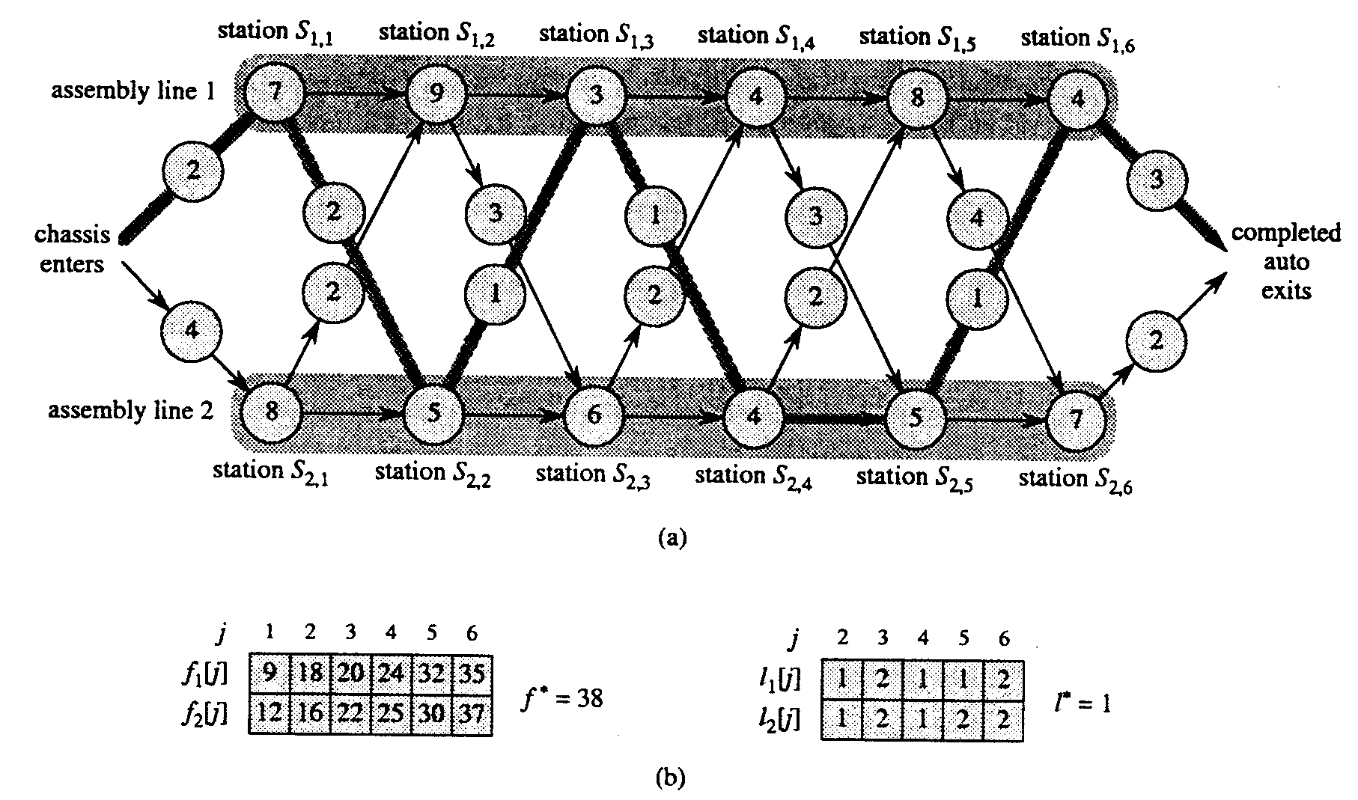
Example

Slide 17
The special order car assembly problem example 2
Compute the fastest way to build a car
Station 1 Station 2 Station 3
1
2
a_{1,3}=5
5
3
3
1
3
s
t
5
1
1
2
2
2
3
Station 1 Station 2 Station 3

Slide 18
Multiplying a sequence of matrices
Given a sequence of matrices
(A₁, A₂,…,A_{n}) where each A_{i} (for i=1,…,n) has d_{i-1} rows and d_{i} columns
Multiplying a sequence of n matrices is very time consuming

Slide 19
The problem
In which order should we multiply the matrices so that the number of multiplications is minimized?
We are prepared to spend some time to compute the best order, in order to save on the number of multiplications done when the sequence of matrices is multiplied

Slide 20
Solving the problem
Multiplying two matrices
Does order matter?
How many are there?
Optimal substructure
Deriving the recurrence equation
The dynamic programming solution

Slide 21
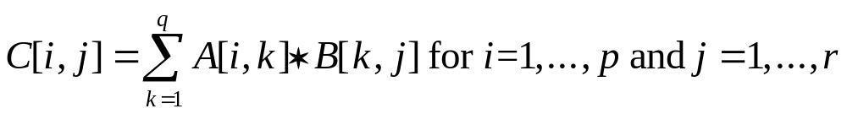
Multiplying two matrices
Let A, B be matrices
Assume A has p rows and q columns
Assume B has q rows and r columns.
Let C=A*B

Slide 22
Multiplying two matrices
C[i, j] is the inner product of the ith row of A by the jth column of B.
C can be computed only when:
  A’s number of columns = B’s number of rows
C=A*B has p rows and r columns.
The number of multiplications to compute A*B using the inner product formula is p*q*r

Slide 23
Multiplying two matrices
Matrix multiplication is associative (A*(B*C))=((A*B)*C)
It is not commutative (A*B) ≠ (B*A)
The number of multiplications done when two large matrices are multiplied is large
Let p=q=r=1000. The number of multiplications is 10⁹.

Slide 24
Does multiplication order matter?
The dimensions of A₁, A₂, A₃, and A₄ are 10*20, 20*50, 50*1, and 1*100 respectively.
For (A₁* (A₂*(A₃*A₄))) we need 125000 multiplications
For (A₁* (A₂*A₃) )*A₄) we need 2200 multiplications
The answer is YES!

Slide 25
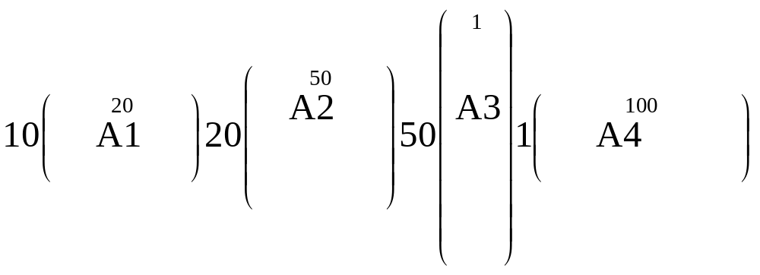
Number of multiplications for (A₁* (A₂*(A₃*A₄)))
A’’
A’
A’=A3*A4 is a 50*100 matrix, requires 50*1*100
A’’=A2*A’ is a 20*100 matrix, requires 20*50*100
A’’’=A1*A’’ is a 10*100 matrix, requires 10*20*100
Total = 5000+100,000+20,000=125,000

Slide 26
Number of multiplications for (A₁* (A₂*A₃) )*A₄)
A’’
A’
A’=A2*A3 is a 20*1 matrix, requires 20*50*1
A’’=A1*A’ is a 10*1 matrix, requires 10*20*1
A’’’=A’’*A4 is a 10*100 matrix, requires 10*1*100
Total = 1,000+200+ 1,000=2,200

Slide 27
How many different orders are there?
1 for n=2. (A₁*A₂).
2 for n=3. ((A₁*A₂)*A₃) and (A₁*(A₂*A₃))
5 for n=4.
(((A₁*A₂)*A₃) *A₄) ((A₁*A₂)*(A₃ *A₄))
(A₁*((A₂*A₃)*A₄))) (((A₁* (A₂*A₃))*A₄)
(A₁* (A₂*(A₃*A₄)))

Slide 28
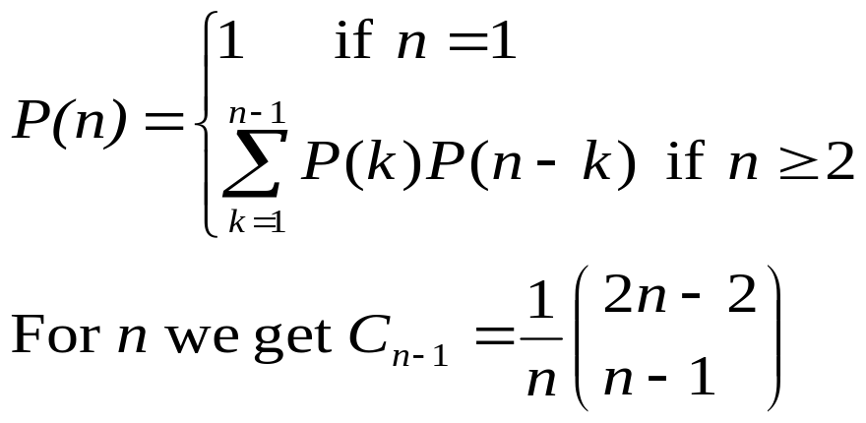
How many different orders are there?
Checking all possible orders is too time consuming
A much faster method needs to be found

Slide 29
The two stage solution
We first solve a simpler problem:
What is the minimum number of multiplications needed?
Information saved during the computation of the minimum, enables deriving the best order

Slide 30
Step 1: The structure of an optimal solution
Let M(i, j) be the minimum number of multiplications needed to compute the sequence A_{i}*A_{i+1}*…*A_{j}
We want to compute M(1,n)
When i=j, M(i,i)=0.

Slide 31
Optimal substructure
Theorem: The computation of subsequences of a multiplication sequence with a minimal number of multiplications, also uses a minimum number of multiplications
Proof: If some subsequence did not use a minimum number of multiplications we could substitute its computation by one with a minimum number and get a smaller number of multiplications for the sequence

Slide 32
Step 1
Let A’ and A’’ be the last two matrices multiplied when A_{i}*A_{i+1}*…*A_{j} is computed
Let A’= (A_{i}*A_{i+1}*…*A_{k}) and
A’’= (A_{k+1}*A_{k+2}*…*A_{j})
A’ must be computed using the minimum number of multiplications M(i,k)
A’’ must be computed using the minimum number of multiplications M(k+1,j)

Slide 33
M[i,j] for a given k
The dimension of A’ is d_{i-1}*d_{k}.
The dimension of A’’ is d_{k}*d_{j}.
So (A’*A’’) is computed using d_{i-1}*d_{k} *d_{j} multiplications
So for a given k:
M(i,j)=M(i,k)+M(k+1,j)+ d_{i-1}*d_{k} *d_{j}

Slide 34
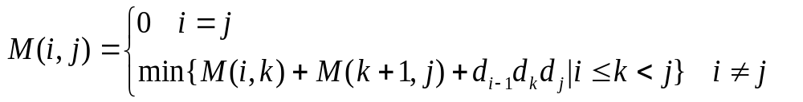
Step 2: Recursive formula for M[i,j]
What is k?
We can only determine k by comparing the minimum number of multiplications for all possible values of k (i.e., k=i,…j-1), and finding the k that provides the minimum

Slide 35
Step 3: The computation
We want to find M(1,n), and an order of matrix multiplications that results in M(1,n)
A recursive procedure would be too slow (15.5 page 345)
We use dynamic programming.
Compute M[i,j] bottom up, and save the values in a matrix

Slide 36
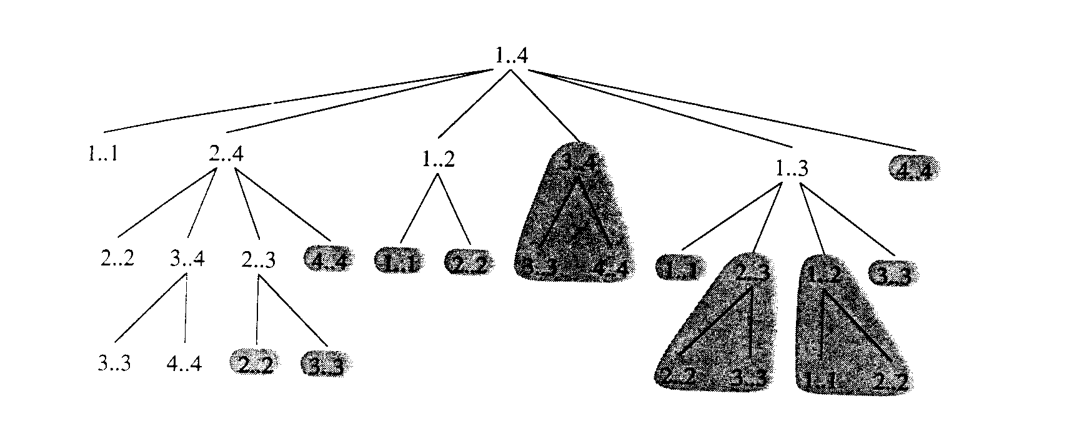
The call tree for 4 matrices
3..4
4,4
4..4
1..1
2..2
Note: 2..3, 3..4, 1..2, are computed twice.

Slide 37
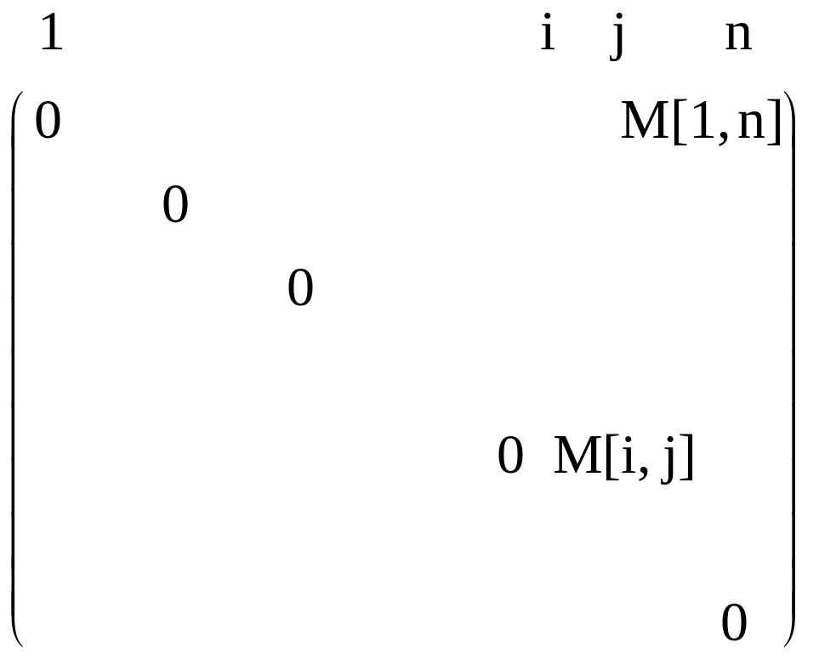
The matrix M
1
i
n

Slide 38
The computation
We initialize the main diagonal to zeroes
We can now fill the next diagonal (where j=i+1 for i=1 to n-1), and continue diagonal by diagonal until M(1,n) is computed
To be able to find the order we set Factor(i,j)=k where k is the index that provided the minimum for M(i,j)

Slide 39
Code for multiplication order
MinMult (d:IntegerArray; n: integer)
  for i:=1 to n do //main diagonal
  M[i,i]:=0
  end;
  for diagonal:=1 to n-1do //the remaining diagonals
    for i:=1 to n-diagonal do
      j:=i+diagonal;
      M[i,j]:=min{M[i,k]+M[k+1,j]+ d_{i-1}*d_{k} *d_{j}|k:=i,..j-1};
      factor[i,j]:=k which gave the minimum;
end {for i};
end {for diagonal};
return M and factor

Slide 40
Analysis
It is easy to show that the algorithm is O(n³)
It calculates approximately n²/2, M[i,j] matrix values
Calculating M[i,j] involves finding the minimum of at most n values. Thus O(n³)
Actually it is also Ω (n³)

Slide 41
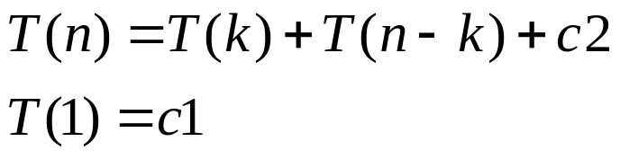
Step 4: Finding the order
Procedure ShowOrder (i,j:integer; factor:Matrix);
k:integer;
if (i=j) then write(‘A’,i)
else k:=factor(i,j);
  write(‘(‘);
  ShowOrder(i,k);
  write(‘*’);
  ShowOrder(k+1,j);
  write(‘)‘);
end {if}
end
ShowOrder. Algorithm is θ(n)
Notes:
It can be shown by induction the W(n)=qn+r

Slide 42
Memoization
Used for recursive code that solves sub problems more than once.
Recursive code is modified as follows:
Step 1: An initialization function is added.
It initializes a table with "impossible values“ and then invokes the recursive function.
This is the table where solution values will be stored.

Slide 43
Memoization
Step 2: The modified recursive function checks the table entry for the value of the solution needed by the subproblem for the call:
  If the table entry contains the “impossible value” the recursive code is used to solve problem and the modified code stores the value of the solution in the table
  If the table entry contains a solution, the modified code returns the value of the solution

Slide 44
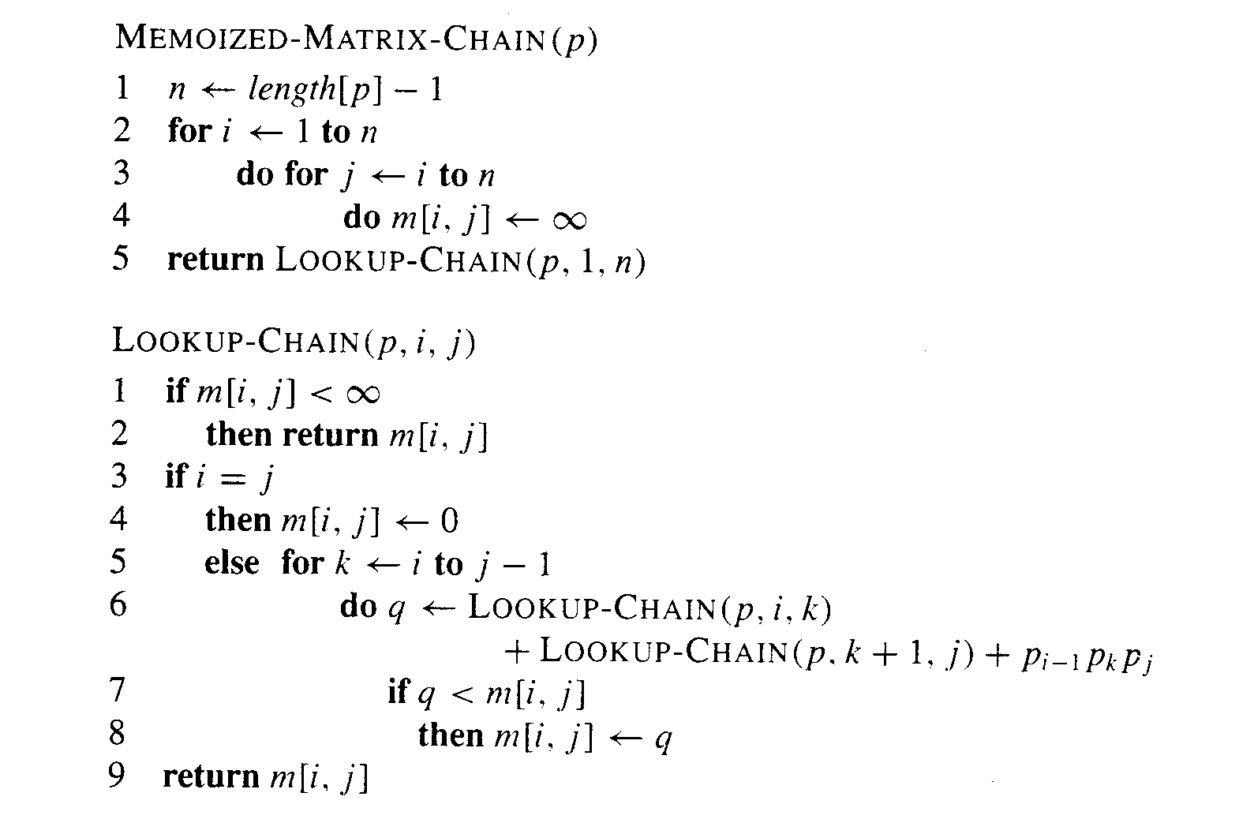
Memoization for matrix multiplication

Slide 45
Fibonacci numbers
The Fibonacci numbers are: f₀ =0, f₁=1
The next number is the sum of the two previous ones, f_{n} = f_{n-1} + f_{n-2}
Write a recursive memoized algorithm for computing the nth Fibonacci number.

Slide 46
MemoizedFib(n)
for (i=0; i<=n; i++)
A[i]=-1 //initialize the array
return LookupFib(n)
LookupFib(n)
//compute fn if not yet done
if A[n]=-1 //initial value
if n<=1 //base case
A[n] = n //store solution
//solve and store general case
else A[n] = (LookupFib(n-1)
+LookupFib(n-2))
return A[n] //return f_{n} = A[n]

